Slide 1

2001: A Space Odyssey (1968) - A Conversation with HAL!
https://www.youtube.com/watch?v=r13I-TuDcWI

Slide 2
2001: A Space Odyssey (1968) - A Conversation with HAL!
https://www.youtube.com/watch?v=r13I-TuDcWI

Slide 3

2001: A Space Odyssey (1968) - HAL Reads Lips
https://www.youtube.com/watch?v=XDO8OYnmkNY

Slide 4
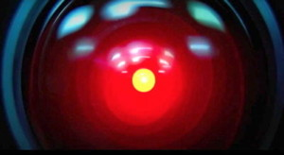
2001: A Space Odyssey (1968) – HAL: I'm Sorry, Dave!
https://www.youtube.com/watch?v=Wy4EfdnMZ5g

Slide 5

The Turing Test
by Alan Turing in 1950
Player C, the interrogator, is given the task of trying to determine which player – A or B – is a computer and which is a human. The interrogator is limited to using the responses to written questions to make the determination.
Notes:
,^{[2]} is a test of a machine's ability to exhibit intelligent behaviour equivalent to, or indistinguishable from, that of a human.
Turing proposed that a human evaluator would judge natural language conversations between a human and a machine designed to generate human-like responses.

Slide 6
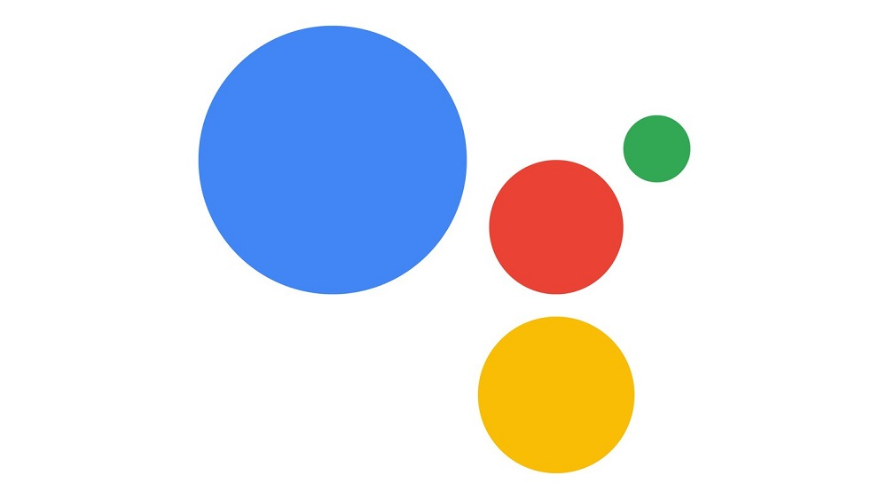
Google Duplex: A.I. Assistant Calls Local Businesses To Make Appointments
https://www.youtube.com/watch?v=D5VN56jQMWM
Notes:
Sundar Pichai
Google’s CEO

Slide 7
Natural Language Understanding
Speech, Text, Emotion, …

Slide 8
Research Priorities for Artificial Intelligence
The capacity for language is one of the central features of human intelligence and is therefore a prerequisite for artificial intelligence.
Despite its many practical applications, language is perhaps number 300 in the priority list for AI research. It would be a great achievement if AI could attain the capabilities of an orangutan, which do not include language!
- Yann LeCun (computer vision researcher)
Russell, Stuart, Daniel Dewey, and Max Tegmark. "Research priorities for robust and beneficial artificial intelligence." Ai Magazine 36.4 (2015): 105-114.

Slide 9
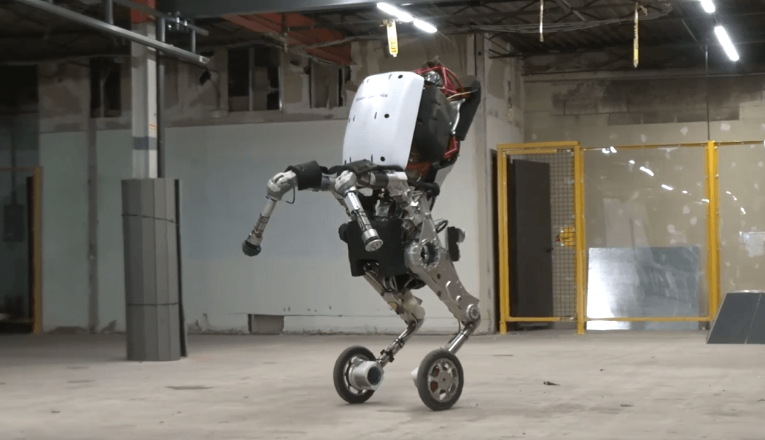
Handle is Boston Dynamics' newest design. It can jump four feet in the air and zip around at nine miles per hour.
https://www.youtube.com/watch?v=7h8mX9ZMs7g

Slide 10
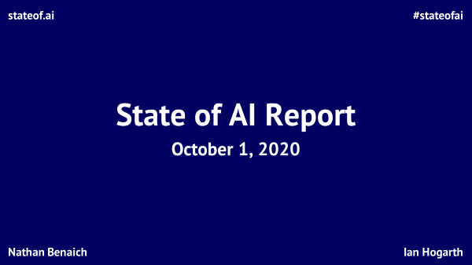

Slide 11


Introduction | Research | Talent | Industry | Politics | Predictions
#stateofai
About the authors
Nathan Benaich
Ian Hogarth
Nathan is the General Partner of Air Street Capital, a venture capital firm investing in AI-first technology and life science companies. He founded RAAIS and London.AI, which connect AI practitioners from large companies, startups and academia, and the RAAIS Foundation that funds open-source AI projects. He studied biology at Williams College and earned a PhD from Cambridge in cancer research.
Ian is an angel investor in 60+ startups. He is a Visiting Professor at UCL working with Professor Mariana Mazzucato. Ian was co-founder and CEO of Songkick, the concert service used by 17M music fans each month. He studied engineering at Cambridge where his Masters project was a computer vision system to classify breast cancer biopsy images. He is the Chair of Phasecraft, a quantum software company.
stateof.ai 2020

Slide 12
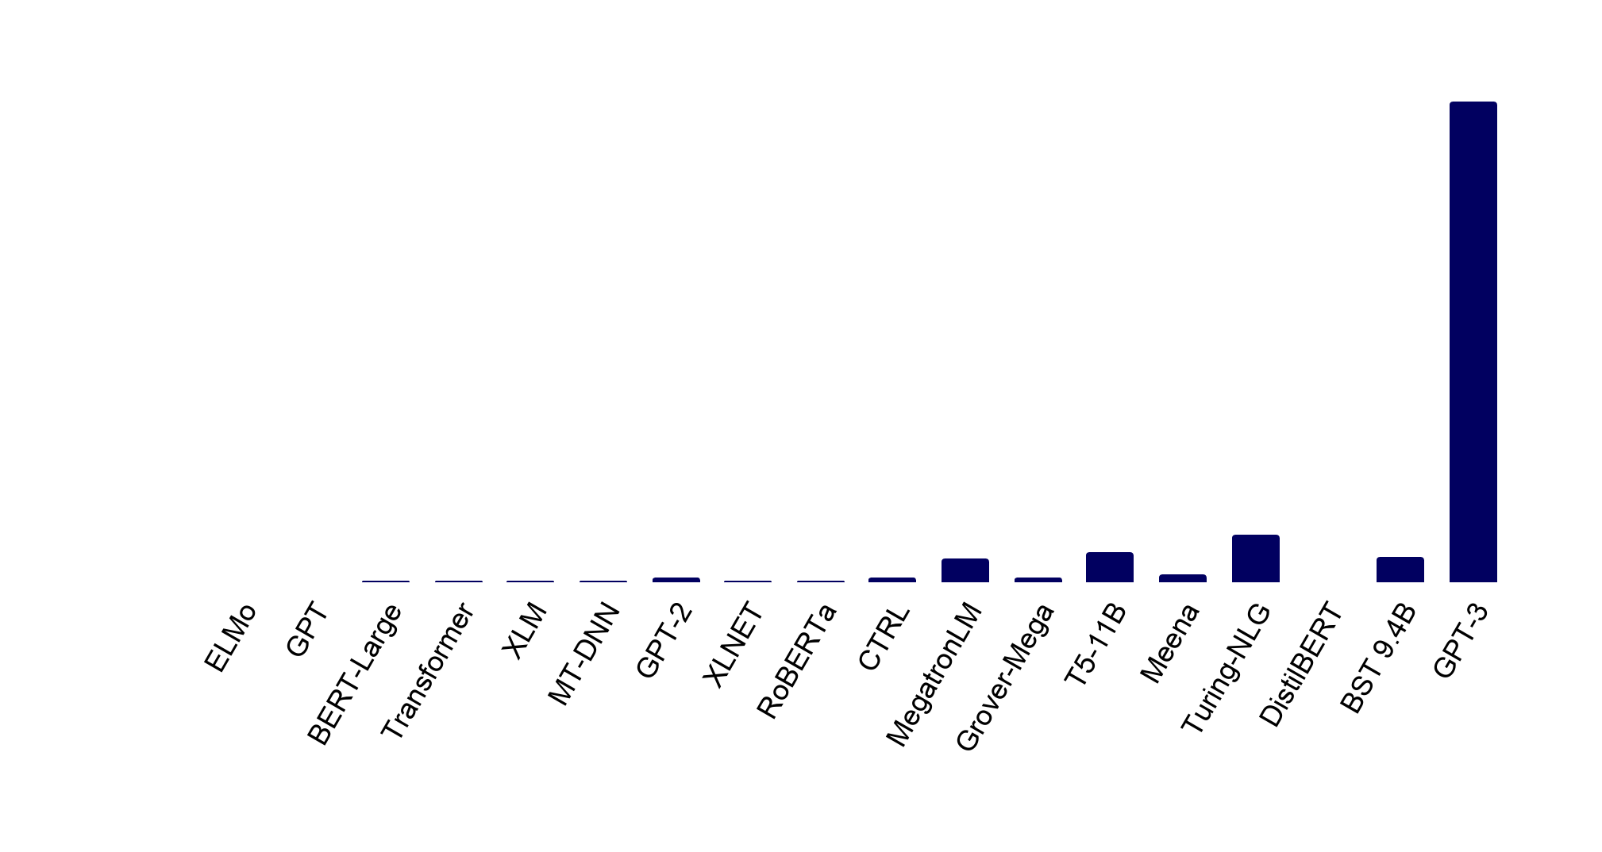
Introduction | Research | Talent | Industry | Politics | Predictions
#stateofai
Language models: Welcome to the Billion Parameter club
Huge models, large companies and massive training costs dominate the hottest area of AI today, NLP.
2018 (left) through 2019 (right)
2020 onwards
175B
8.3B
11B
17B
9.4B
94M
1.5B
1.5B
1.5B
2.6B
110M
340M
465M
665M
330M
340M
355M
66M
stateof.ai 2020
Note: The number of parameters indicates how many different coefficients the algorithm optimizes during the training process.
Notes:
Source: individual papers on said models

Slide 13
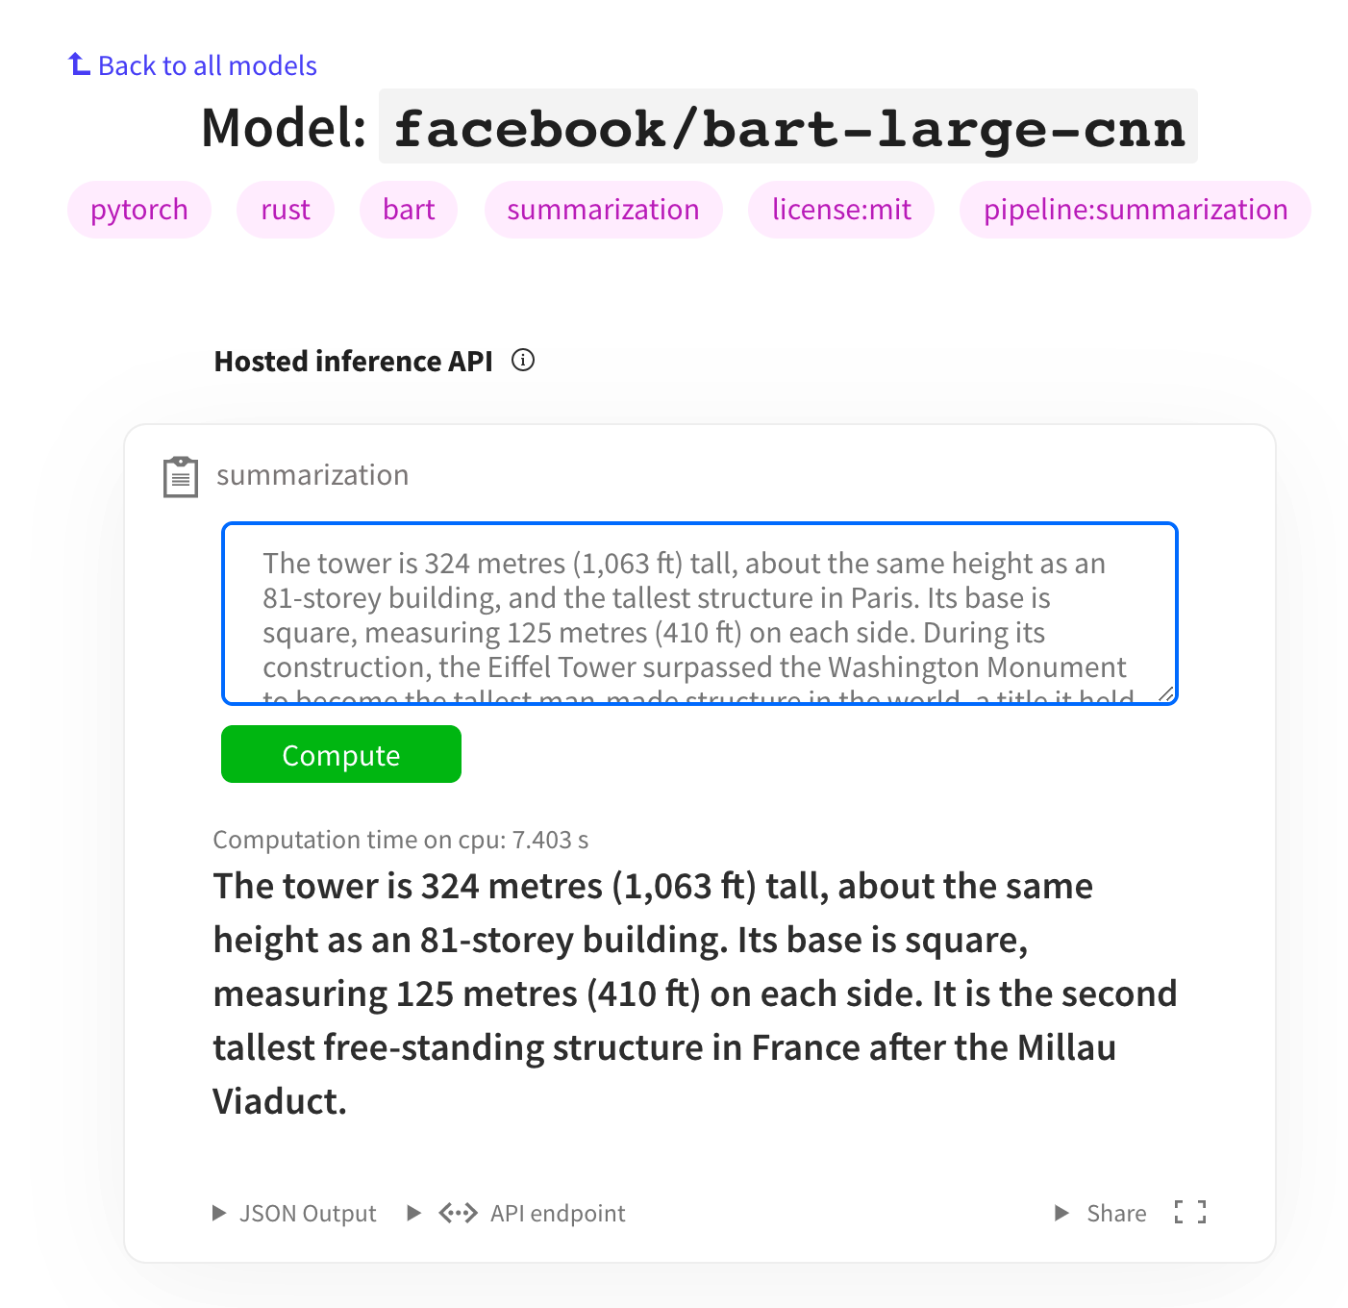
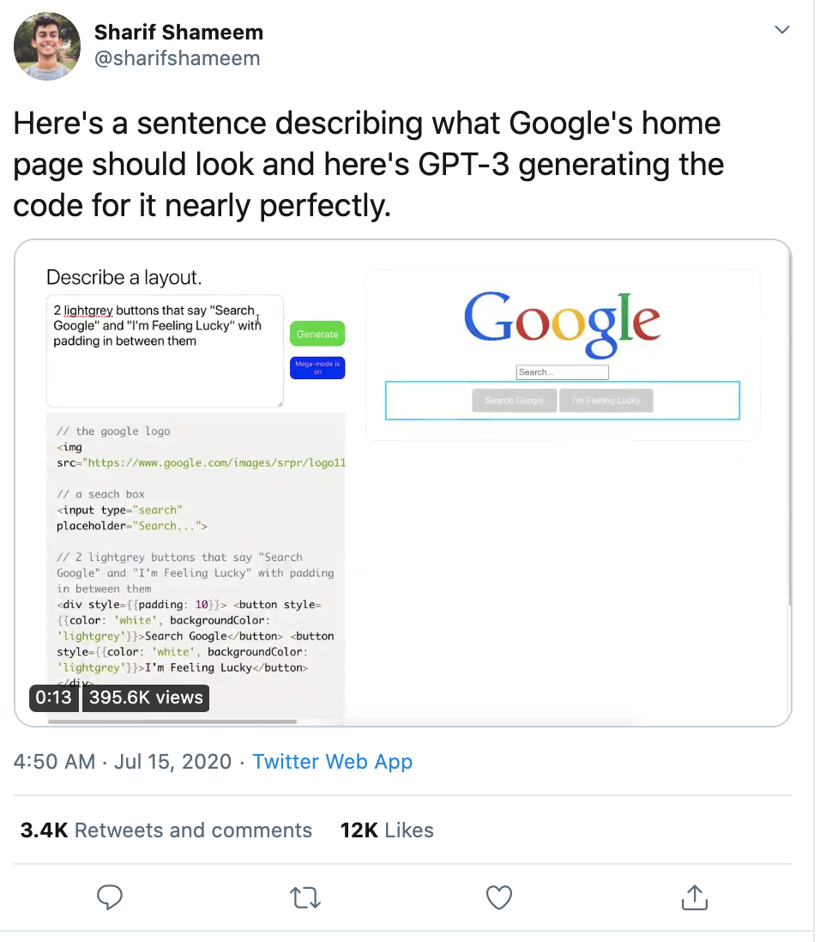

Introduction | Research | Talent | Industry | Politics | Predictions
#stateofai
A new generation of transformer language models are unlocking new NLP use-cases
GPT-3, T5, BART are driving a drastic improvement in the performance of transformer models for text-to-text
tasks like translation, summarization, text generation, text to code.
Summarization from huggingface.co/models
Code generation and more: gpt3examples.com
stateof.ai 2020
Notes:
Source: https://huggingface.co/distilbert-base-cased-distilled-squad?text=Where+do+I+live%3F&context=My+name+is+Sarah+and+I+live+in+London.

Slide 14
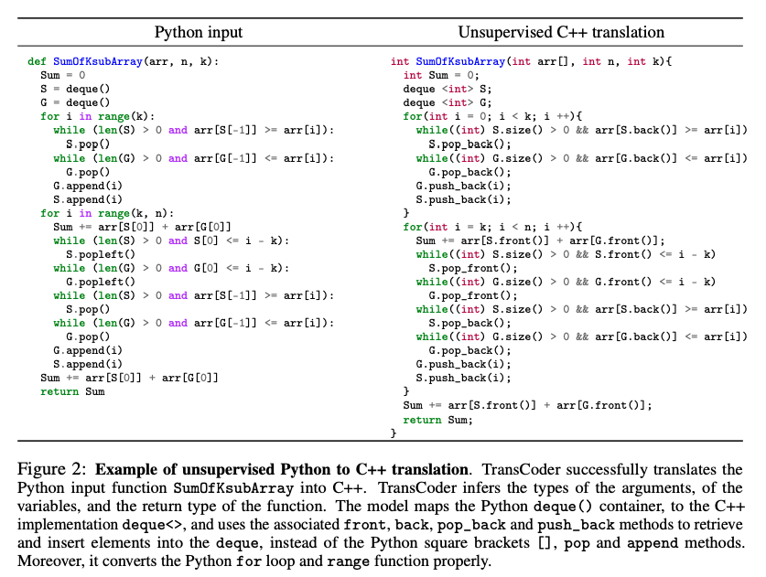

Introduction | Research | Talent | Industry | Politics | Predictions
#stateofai
Computer, please convert my code into another programming language
An unsupervised machine translation model trained on GitHub projects with 1,000 parallel functions can
translate 90% of these functions from C++ to Java and 57% of Python functions into C++ and successfully pass
unit tests. No expert knowledge required, but no guarantees that the model didn’t memorize the functions either.
stateof.ai 2020
Notes:
Source: https://arxiv.org/pdf/2006.03511.pdf

Slide 15
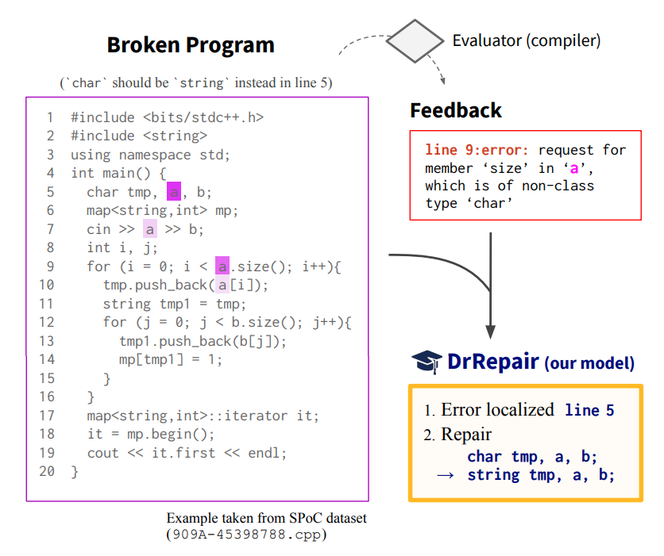
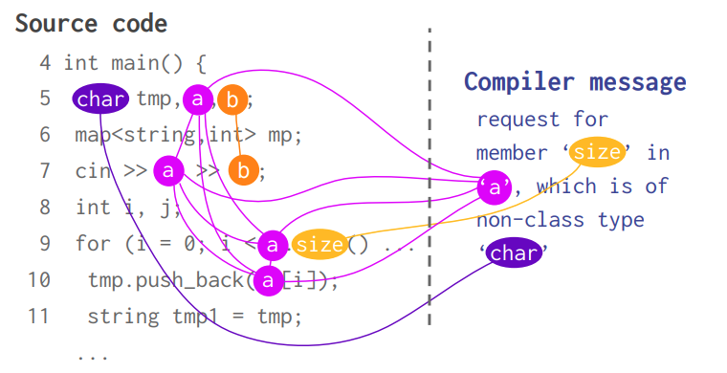

Introduction | Research | Talent | Industry | Politics | Predictions
#stateofai
Computer, can you automatically repair my buggy programs too?
Given a broken program and diagnostic feedback (compiler error message), DrRepair localizes an erroneous
line and generates a repaired line.
The model jointly reasons over the broken source code and the diagnostic feedback using graph neural networks.
They use self-supervised learning to obviate the need for labelling by taking code from programming competitions and corrupting it into a broken program.
A SOTA is set on DeepFix, which is a program repair benchmark for correct intro programming assignments in C.
stateof.ai 2020
Notes:
Source: https://arxiv.org/abs/2005.10636

Slide 16

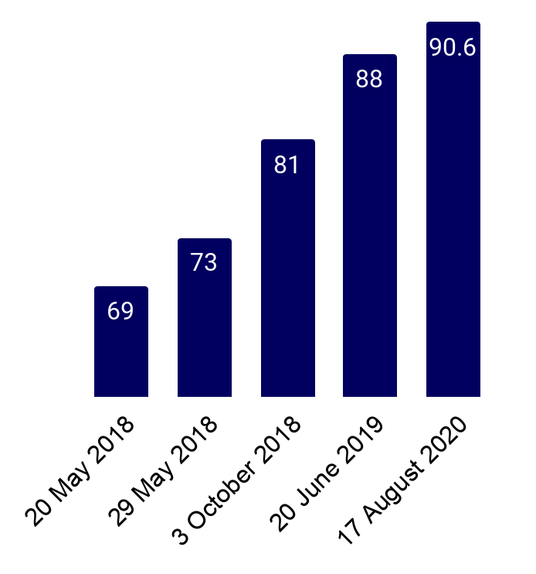

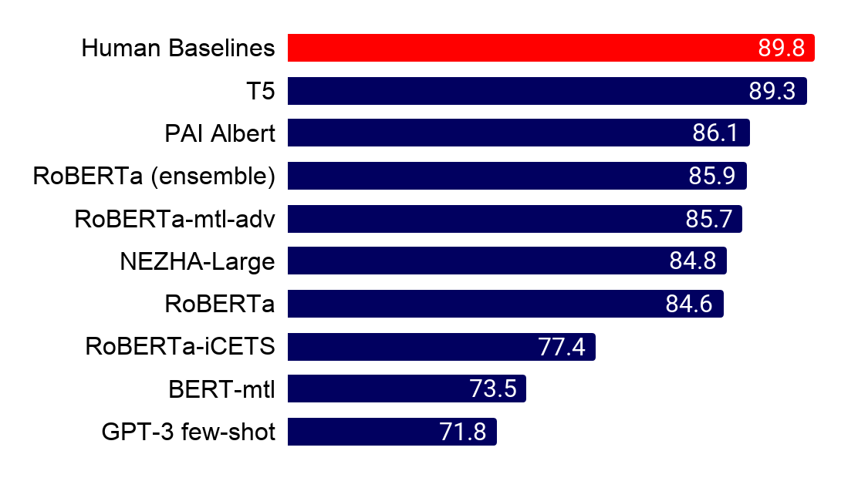
Introduction | Research | Talent | Industry | Politics | Predictions
#stateofai
NLP benchmarks take a beating: Over a dozen teams outrank the human GLUE baseline
It was only 12 months ago that the human GLUE benchmark was beat by 1 point. Now SuperGLUE is in sight.
GLUE and it's more challenging sibling SuperGLUE are benchmarks that evaluate NLP systems at a range of tasks spanning logic, common sense understanding, and lexical semantics. The human benchmark on GLUE is reliably beat today (right) and the SuperGLUE human benchmark is almost surpassed too!
Human baseline = 87
stateof.ai 2020
Notes:
Source: https://gluebenchmark.com/
Source: https://super.gluebenchmark.com/

Slide 17
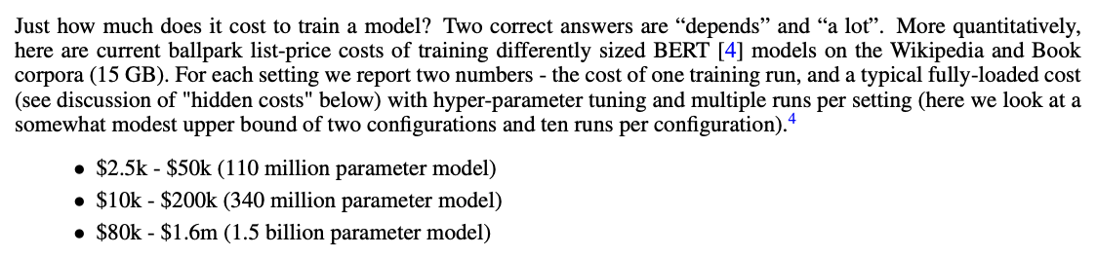
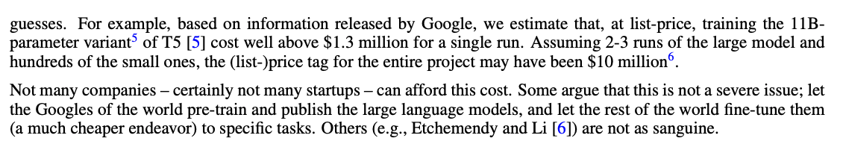

Introduction | Research | Talent | Industry | Politics | Predictions
#stateofai
Tuning billions of model parameters costs millions of dollars
Based on variables released by Google et al., you’re paying circa $1 per 1,000 parameters. This means OpenAI’s
175B parameter GPT-3 could have cost tens of millions to train. Experts suggest the likely budget was $10M.
stateof.ai 2020
Notes:
Source: https://arxiv.org/pdf/2004.08900.pdf

Slide 18
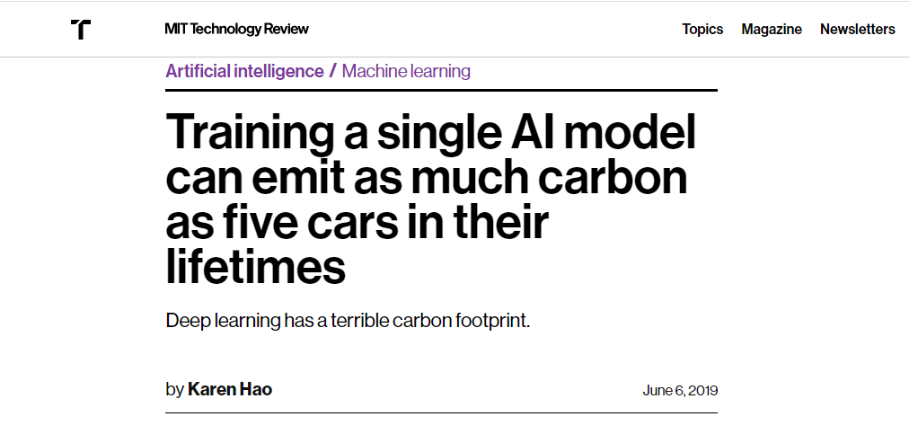

Slide 19
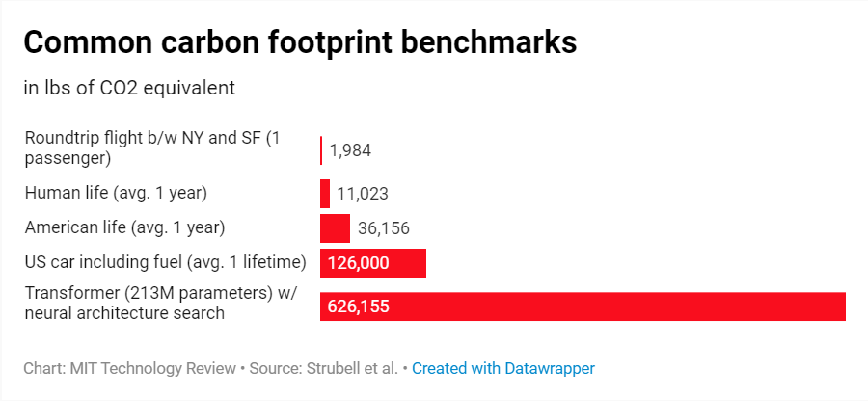
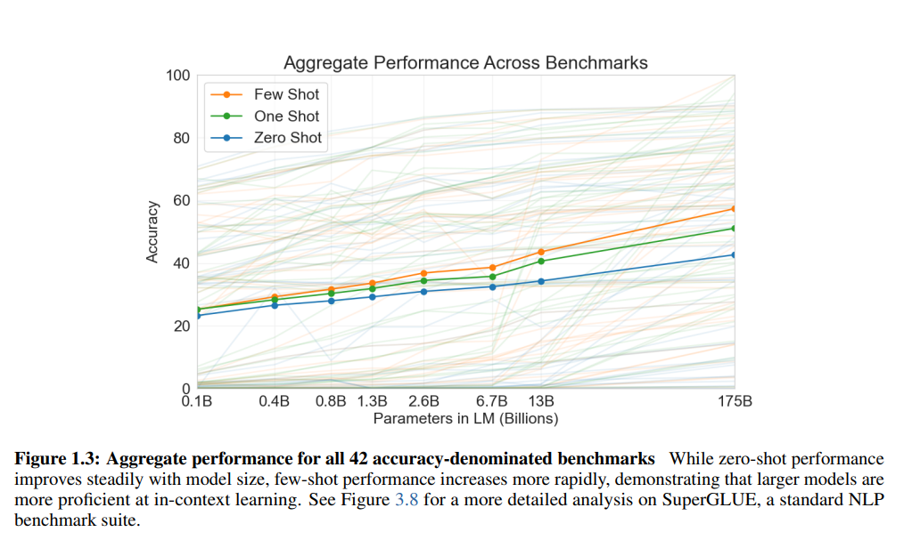

Slide 20
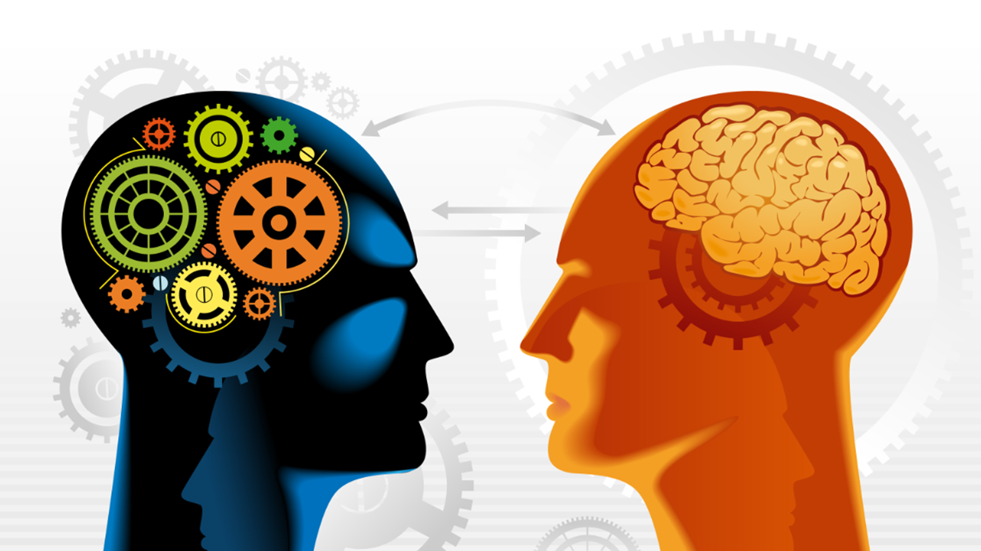
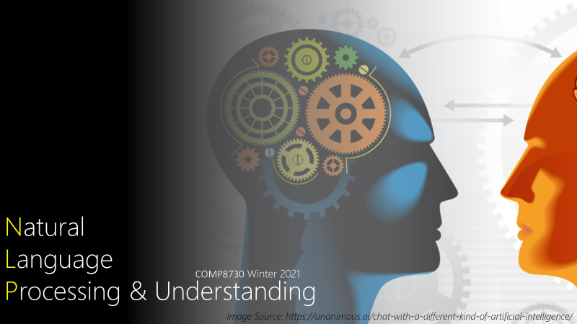
Natural
Language
Processing & Understanding
COMP8730 Winter 2021
Image Source: https://unanimous.ai/chat-with-a-different-kind-of-artificial-intelligence/

Slide 21
background

Slide 22
Background
Computer Science
Mathematic
Linguistics

Slide 23
Background: the course is targeted at computer scientists!
Assumed to know
Design of Algorithms
Greedy
Dynamic Programming
Divide-Conquer
Recursion
Backtracking
Analysis of Algorithms
Time & Space (memory)
Big O
Complexity Theory
Data Modeling
Data Structure
Computer Science
Mathematic
Linguistics

Slide 24
Background: the course is targeted at computer scientists!
Computer Science
Mathematic
Courses
- COMP2540: Data Structures and Algorithms
- COMP3540: Theory of Computation
- COMP4540: Design and Analysis of Computer Algorithms
Linguistics

Slide 25
Background: the course is targeted at computer scientists!
Computer Science
Mathematic
References
- Introduction to algorithms (3rd ed.), Cormen, et al. (2009).
- Introduction to the Theory of Computation. Sipser, M. (2012).
Linguistics

Slide 26
Background: the course is targeted at computer scientists!
Assumed to know
Multivariate Calculus
Derivatives
Partial Derivatives
Linear Algebra
Vectors
Matrices
Probability & Statistics
Computer Science
Mathematic
Linguistics
Notes:
. A review of basic probability
is found in Appendix A, and a minimal review of numerical optimization is
found in Appendix B. For linear algebra, the online course and textbook from Strang
(2016) provide an excellent review. Deisenroth et al. (2018) are currently preparing
a textbook on Mathematics for Machine Learning, a draft can be found online.1 For
an introduction to probabilistic modeling and estimation, see James et al. (2013); for
1https://mml-book.github.io/
i
ii PREFACE
a more advanced and comprehensive discussion of the same material, the classic
reference is Hastie et al. (2009)

Slide 27
Background: the course is targeted at computer scientists!
Computer Science
Mathematic
References
- Mathematics for Machine Learning, Deisenroth et al.
a draft can be found online at https://mml-book.github.io/
Linguistics

Slide 28
Background: the course is targeted at computer scientists!
Computer Science
Assumed to know
Elementary concepts
Part-of-Speech (Nouns, Verbs, …)
English Grammar
Mathematic
References
- Linguistic Fundamentals for Natural Language Processing:
100 Essentials from Morphology and Syntax, Bender, E. M. (2013).
Linguistics

Slide 29
Approach

Slide 30
Natural Language Processing & Text Mining
The goal is to provide new computational capabilities for applications
E.g., predict next form of a word for branding!
extracting information from texts,
translating between languages,
answering questions,
holding a conversation,
taking instructions,
….
Computational Linguistics
Here, language is the object of study.
Computational methods are to support.
Just as in computational biology
E.g, how a word is evolving in time?
Discourse analysis
Parsing
Machine Learning & Data Mining
Methods of learning from data.
Text data needs special care! Why?

Slide 31
Approach: unstructured vs. structured
Statistical
Learning
Structural
Search

Slide 32
Approach: unstructured vs. structured
Examples
Lemmatization
converts the word to its meaningful base form, which is called Lemma. The same word may have multiple different Lemmas
Stemming
removes or stems the last few characters of a word, often leading to incorrect meanings and spelling
Segmentation
dividing written text into meaningful units, such as words, sentences, or topics
Tenses of a Verb
present, present perfect, past tenses of verbs
Statistical
Learning
Structural
Search

Slide 33
Approach: unstructured vs. structured
Examples
Lemmatization → lemma(word) = drop ‘s’ or ‘es’ from the end
converts the word to its meaningful base form, which is called Lemma. The same word may have multiple different Lemmas
Statistical
Learning
Structural
Search
Notes:
Inflection: Inflected word

Slide 34
Approach: unstructured vs. structured
Examples
Lemmatization → lemma(‘books’) = ‘book’
converts the word to its meaningful base form, which is called Lemma. The same word may have multiple different Lemmas
Statistical
Learning
Structural
Search
Notes:
Inflection: Inflected word

Slide 35
Approach: unstructured vs. structured
Examples
Lemmatization → lemma(‘indices’) = ‘indic’
converts the word to its meaningful base form, which is called Lemma. The same word may have multiple different Lemmas
Statistical
Learning
Structural
Search
Notes:
Inflection: Inflected word

Slide 36
Approach: unstructured vs. structured
Statistical
Learning
Structural
Search

Slide 37
Approach: unstructured vs. structured
Examples
Lemmatization → lemma(‘indices’)
converts the word to its meaningful base form, which is called Lemma. The same word may have multiple different Lemmas
https://en.wikipedia.org/wiki/Database_index
A database index is a data structure that improves the speed of data retrieval operations on a database table at the cost of additional writes and storage space to maintain the index data structure. Indexes are used to quickly locate data without having to search every row in a database table every time a database table is accessed. Indexes can be created using one or more columns of a database table, providing the basis for both rapid random lookups and efficient access of ordered records. An index is a copy of selected columns of data from a table, called a database key or simply key, that can be searched very efficiently that also includes a low-level disk block address or direct link to the complete row of data it was copied from. Some databases extend the power of indexing by letting developers create indexes on functions or expressions. For example, an index could be created on upper(last_name), which would only store the upper-case versions of the last_name field in the index. Another option sometimes supported is the use of partial indices, where index entries are created only for those records that satisfy some conditional expression. A further aspect of flexibility is to permit indexing on user-defined functions, as well as expressions formed from an assortment of built-in functions.
Statistical
Learning
Structural
Search
Notes:
Inflection: Inflected word

Slide 38
Approach: unstructured vs. structured
Examples
Lemmatization → lemma(‘indices’)
converts the word to its meaningful base form, which is called Lemma. The same word may have multiple different Lemmas
https://en.wikipedia.org/wiki/Database_index
A database index is a data structure that improves the speed of data retrieval operations on a database table at the cost of additional writes and storage space to maintain the index data structure. Indexes are used to quickly locate data without having to search every row in a database table every time a database table is accessed. Indexes can be created using one or more columns of a database table, providing the basis for both rapid random lookups and efficient access of ordered records. An index is a copy of selected columns of data from a table, called a database key or simply key, that can be searched very efficiently that also includes a low-level disk block address or direct link to the complete row of data it was copied from. Some databases extend the power of indexing by letting developers create indexes on functions or expressions. For example, an index could be created on upper(last_name), which would only store the upper-case versions of the last_name field in the index. Another option sometimes supported is the use of partial indices, where index entries are created only for those records that satisfy some conditional expression. A further aspect of flexibility is to permit indexing on user-defined functions, as well as expressions formed from an assortment of built-in functions.
Statistical
Learning
Structural
Search
Notes:
Inflection: Inflected word

Slide 39
Approach: unstructured vs. structured
Examples
Segmentation
dividing written text into meaningful units, such as words (tokenizer), sentences, or topics
https://www.nltk.org/_modules/nltk/tokenize/punkt.html
Punkt knows that the periods in Mr. Smith and Johann S. Bach do not mark sentence boundaries. And sometimes sentences can start with non-capitalized words. i is a good variable name.
https://en.wikipedia.org/wiki/Database_index
Adatabaseindexisadatastructurethatimprovesthespeedofdataretrievaloperationsonadatabasetableatthecostofadditionalwritesandstoragespacetomaintaintheindexdatastructure.Indexesareusedtoquicklylocatedatawithouthavingtosearcheveryrowinadatabasetableeverytimeadatabasetableisaccessed.IndexescanbecreatedusingoneormorecolumnsofadatabasetableasexplainedinSect.2.1.4,providingthebasisforbothrapidrandomlookupsandefficientaccessoforderedrecords.Anindexisacopyofselectedcolumnsofdatafromatable,calledadatabasekeyorsimplykey,thatcanbesearchedveryefficientlythatalsoincludesalowleveldiskblockaddressordirectlinktothecompleterowofdataitwascopiedfrom.Somedatabasesextendthepowerofindexingbylettingdeveloperscreateindexesonfunctionsorexpressions.Forexample,anindexcouldbecreatedonupper(last_name),whichwouldonlystoretheuppercaseversionsofthelast_namefieldintheindex.Anotheroptionsometimessupportedistheuseofpartialindices,whereindexentriesarecreatedonlyforthoserecordsthatsatisfysomeconditionalexpression.Afurtheraspectofflexibilityistopermitindexingonuserdefinedfunctions,aswellasexpressionsformedfromanassortmentofbuilt-infunctions.
Statistical
Learning
Structural
Search
Notes:
Inflection: Inflected word

Slide 40
Approach: unstructured vs. structured
Examples
Segmentation
dividing written text into meaningful units, such as words (tokenizer), sentences, or topics
https://www.nltk.org/_modules/nltk/tokenize/punkt.html
Punkt knows that the periods in Mr. Smith and Johann S. Bach do not mark sentence boundaries. And sometimes sentences can start with non-capitalized words. i is a good variable name.
https://en.wikipedia.org/wiki/Database_index
Adatabaseindexisadatastructurethatimprovesthespeedofdataretrievaloperationsonadatabasetableatthecostofadditionalwritesandstoragespacetomaintaintheindexdatastructure.Indexesareusedtoquicklylocatedatawithouthavingtosearcheveryrowinadatabasetableeverytimeadatabasetableisaccessed.IndexescanbecreatedusingoneormorecolumnsofadatabasetableasexplainedinSect.2.1.4,providingthebasisforbothrapidrandomlookupsandefficientaccessoforderedrecords.Anindexisacopyofselectedcolumnsofdatafromatable,calledadatabasekeyorsimplykey,thatcanbesearchedveryefficientlythatalsoincludesalowleveldiskblockaddressordirectlinktothecompleterowofdataitwascopiedfrom.Somedatabasesextendthepowerofindexingbylettingdeveloperscreateindexesonfunctionsorexpressions.Forexample,anindexcouldbecreatedonupper(last_name),whichwouldonlystoretheuppercaseversionsofthelast_namefieldintheindex.Anotheroptionsometimessupportedistheuseofpartialindices,whereindexentriesarecreatedonlyforthoserecordsthatsatisfysomeconditionalexpression.Afurtheraspectofflexibilityistopermitindexingonuserdefinedfunctions,aswellasexpressionsformedfromanassortmentofbuilt-infunctions.
Statistical
Learning
Structural
Search
Notes:
Inflection: Inflected word

Slide 41
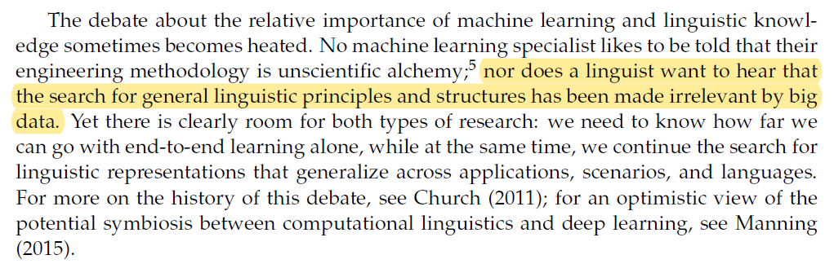
Manning, C. D. (2015). Last words: Computational linguistics and deep learning. Computational Linguistics 41(4), 701–707.

Slide 42
NLP is AI-hard (AI-Complete)
Fundamentally Discrete
Compositional
meaning created by specific combinatorial arrangements of units (chars, words, sentences)
Distribution over words is power law
there will be a few words that are very frequent
long tail of words that are rare
consequently, NLP algorithms must be especially robust to observations that do not occur in the training data

Slide 43
course

Slide 44
Course: Research-oriented, Project-driven
Research
Project
Theory
Assignment

Slide 45
Research project

Slide 46
Research Project
vs.
Software Project

Slide 47
Research Project
Problem Definition
Presentation I: Proposal
Experiment
Conference Submission
Literature Review
Proposed Solution
Presentation II: Demo

Slide 48
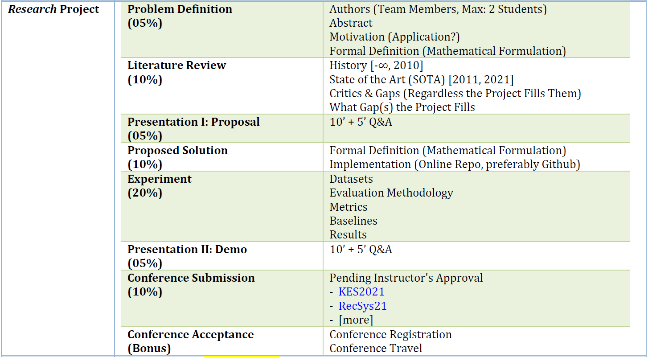

Slide 49
Theory

Slide 50
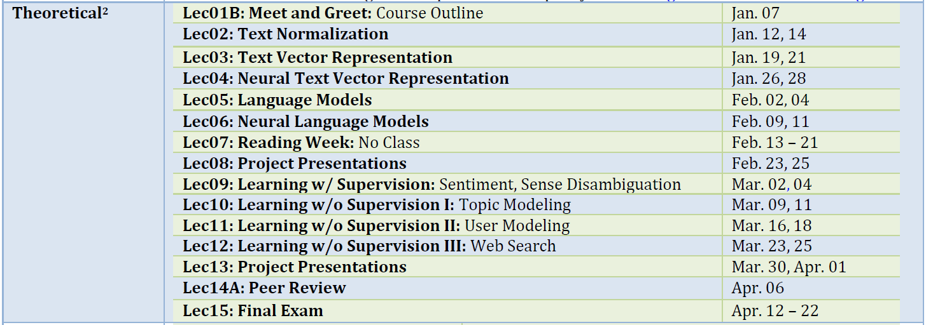

Slide 51
Books & Resources

Slide 52
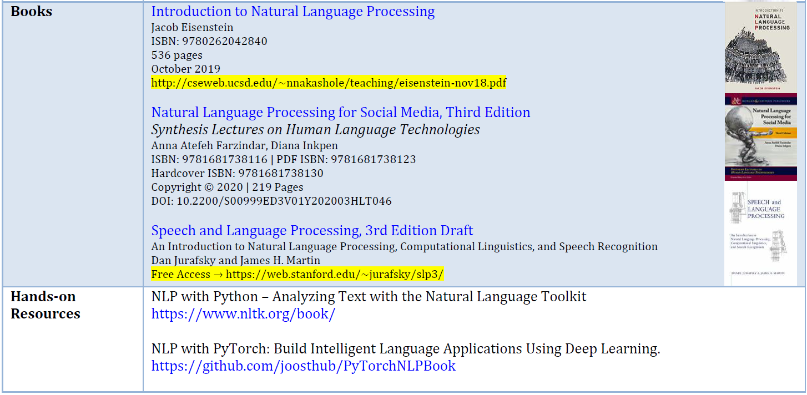

Slide 53
Marking schema

Slide 54
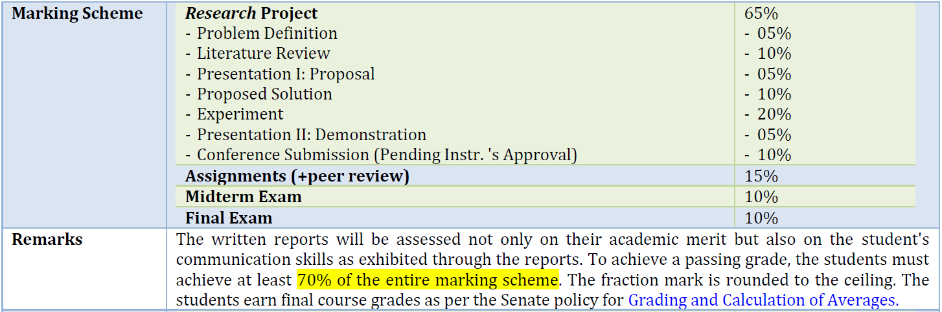

Slide 55
me

Slide 56


Hossein Fani, PhD
Assistant Professor, School of Computer Science, Faculty of Science, University of Windsor
Room 5111, Lambton Tower hfani@uwindsor.ca
hfani.myweb.cs.uwindsor.ca
Notes:
Hossein Fani, http://hfani.myweb.cs.uwindsor.ca/
Education: Ph.D. in CS, Faculty of Computer Science, University of New Brunswick, NB., Canada
Office:
ENG324
Hour
Tuesday 12PM-01PM
Email
hossein.fani@ryerson.ca

Slide 57
OFFICE
Tuesday-Thursday 5:30 PM-6:30 PM

Slide 58
Weekly schedule

Slide 59
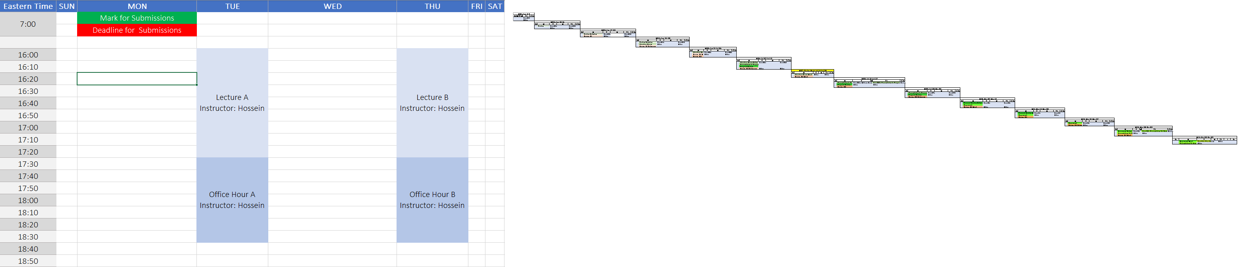
Schedule_Timeline.xlsx

Slide 60
BB tour

Slide 61
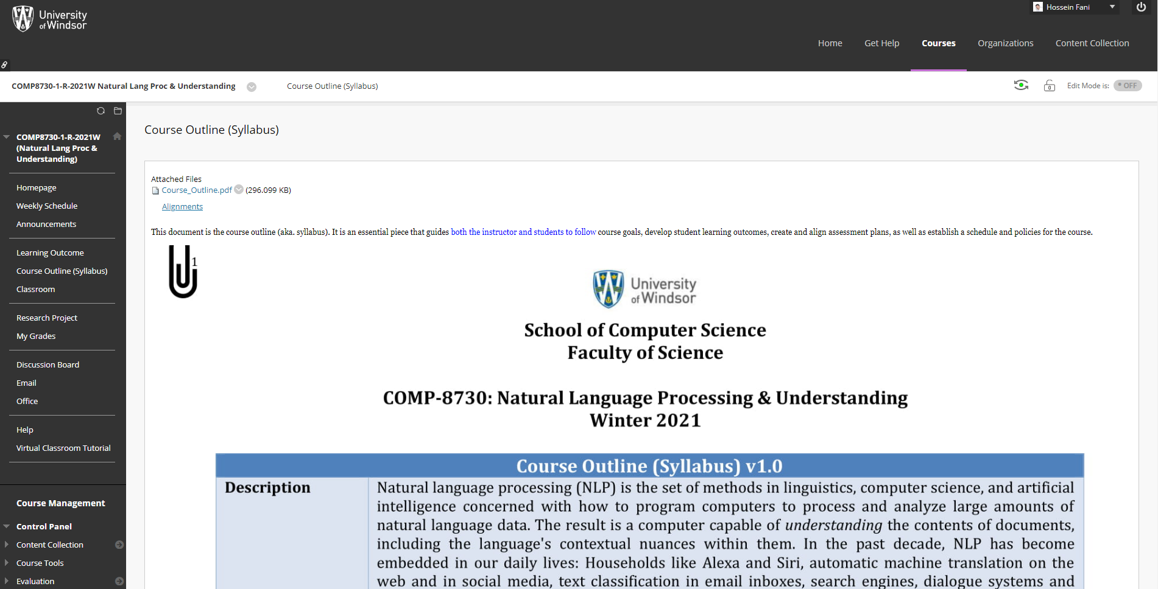

Slide 62


